Slide 1

IOS Testing Report

Slide 2
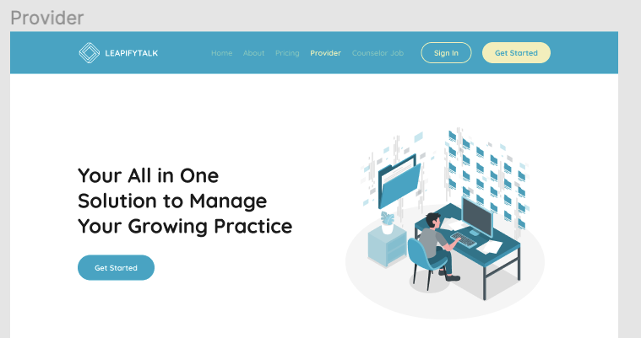
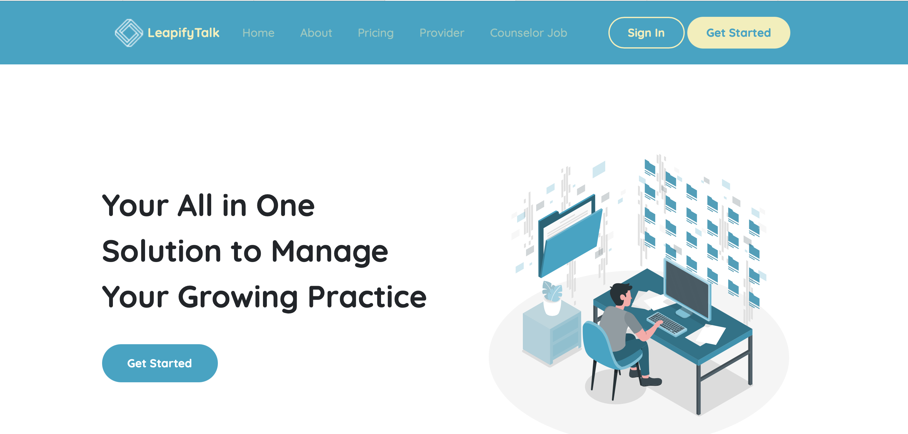
Desktop Testing
Design
Actual
Provider button bar not Highlighting

Slide 3
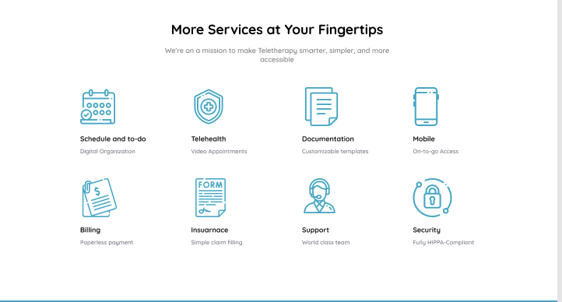
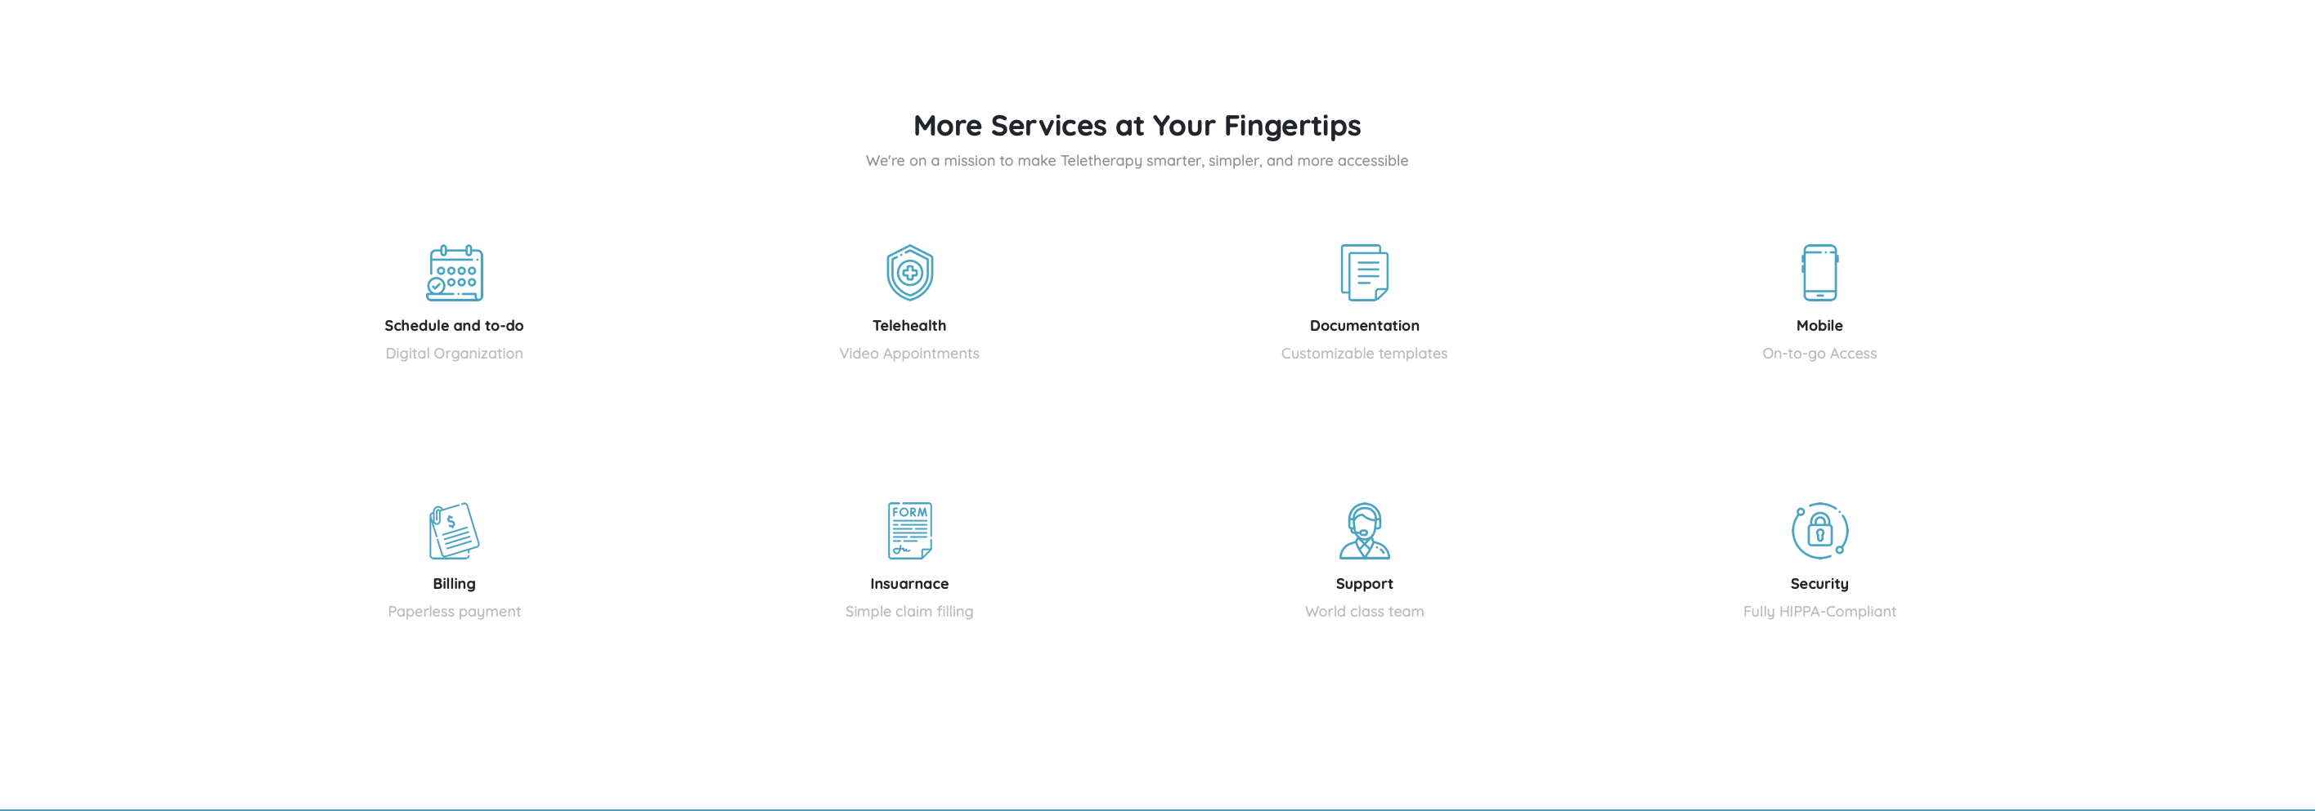
Design
Actual
Size of the icons are small compare to design and not able to
click them.

Slide 4
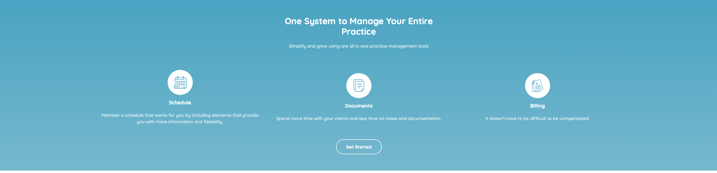
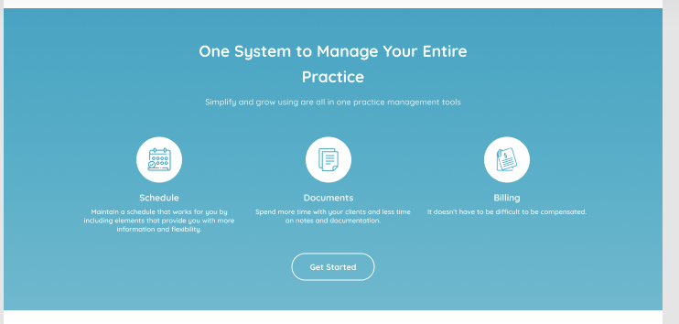
Design
Actual
Not able to click the icons.

Slide 5
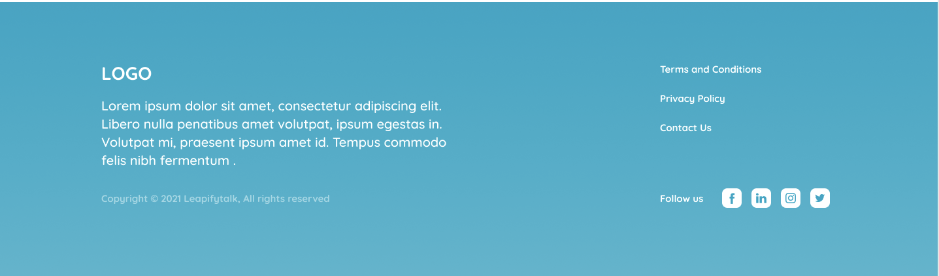
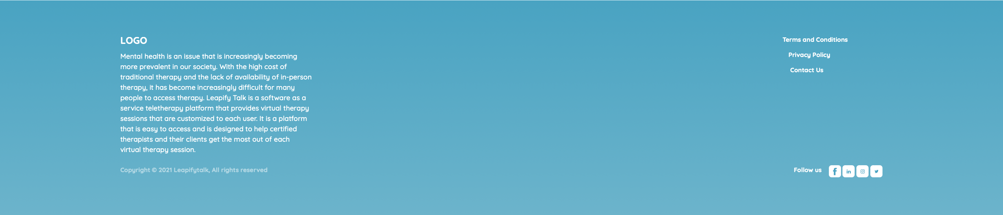
Design
Actual
Logo language is in English

Slide 6
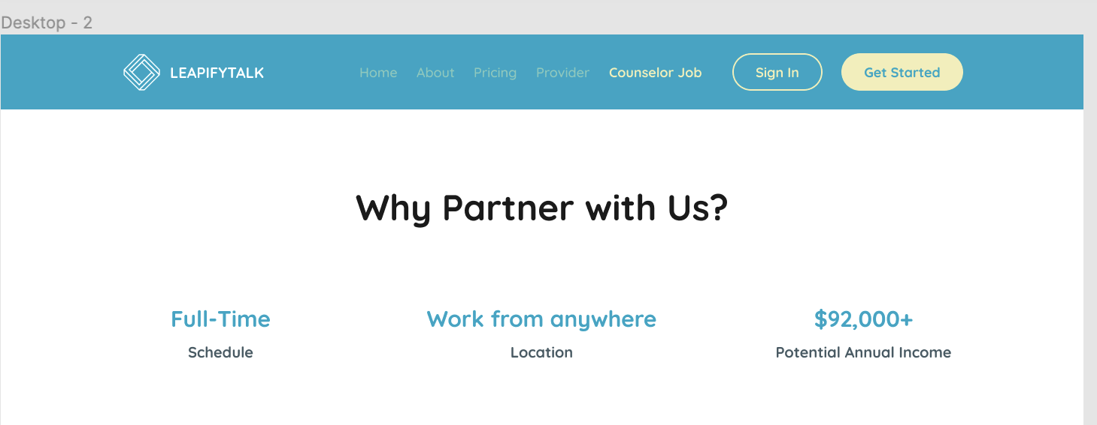
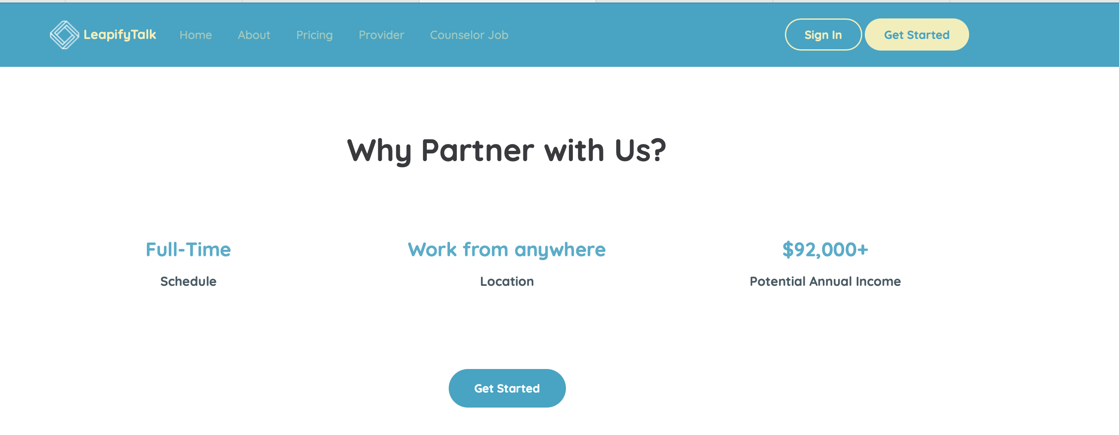
Design
Actual
Get started button in Actual site

Slide 7
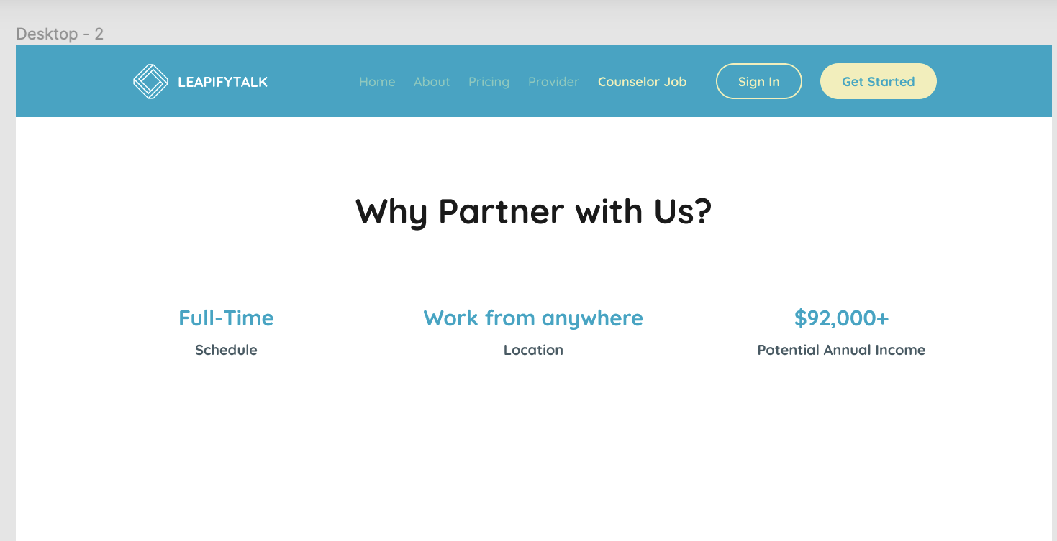
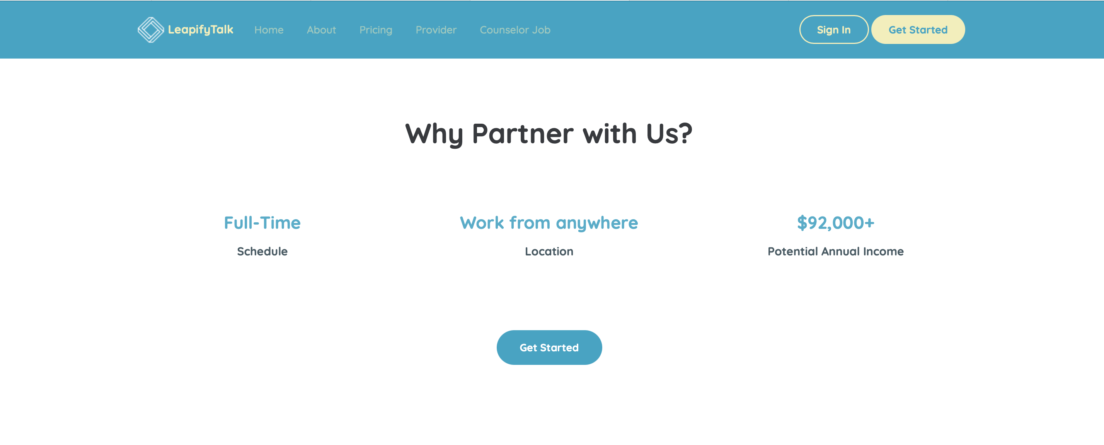
Design
Actual
Counselor job bar not Highlighting

Slide 8
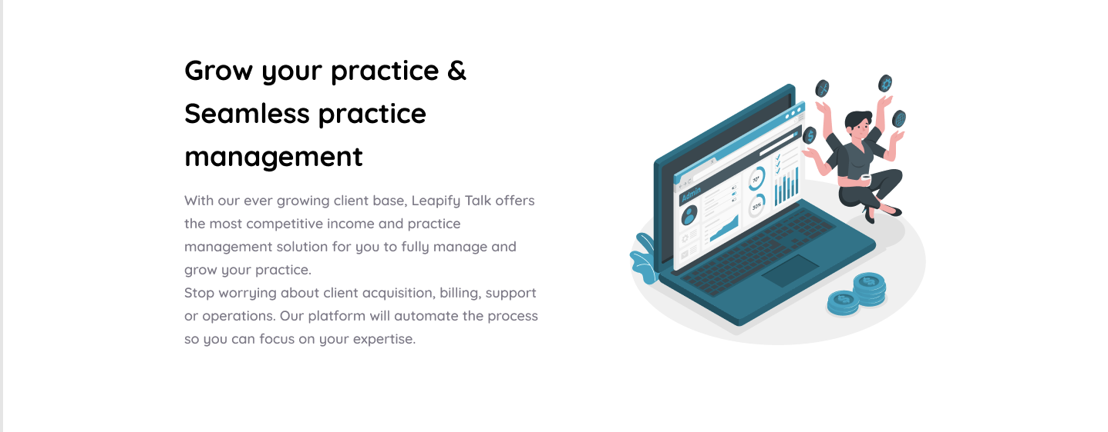

Design
Actual
In Design there are three statements but in actual there are only 2 statements.

Slide 9
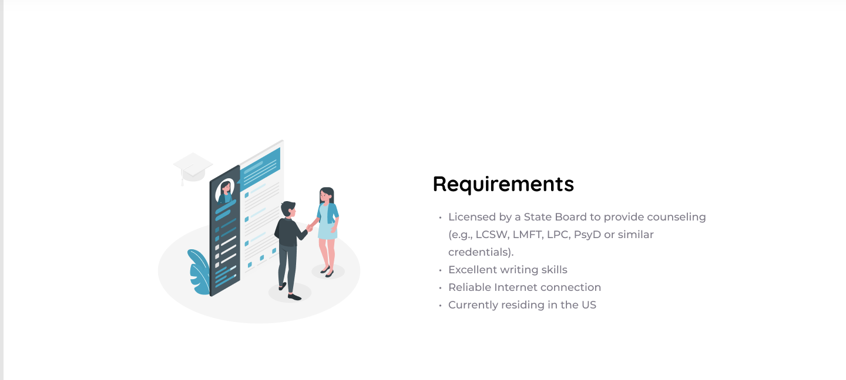

Design
Actual
Bullet buttons are missed in requirements.

Slide 10
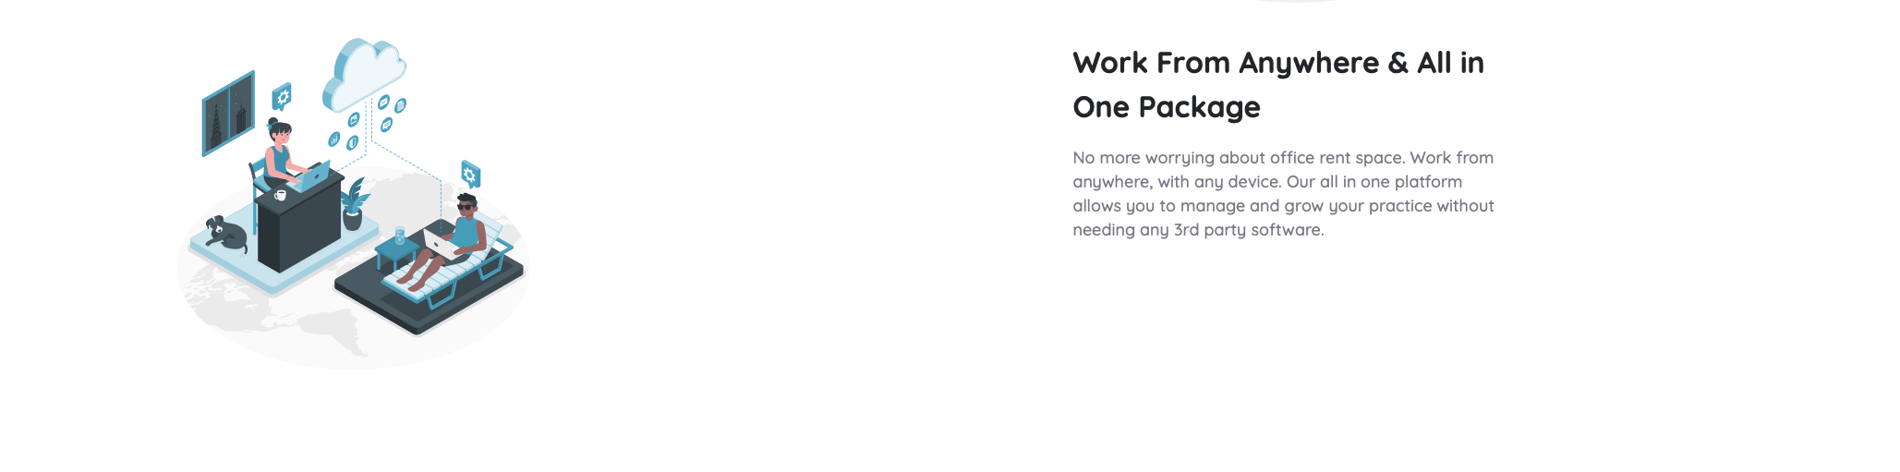
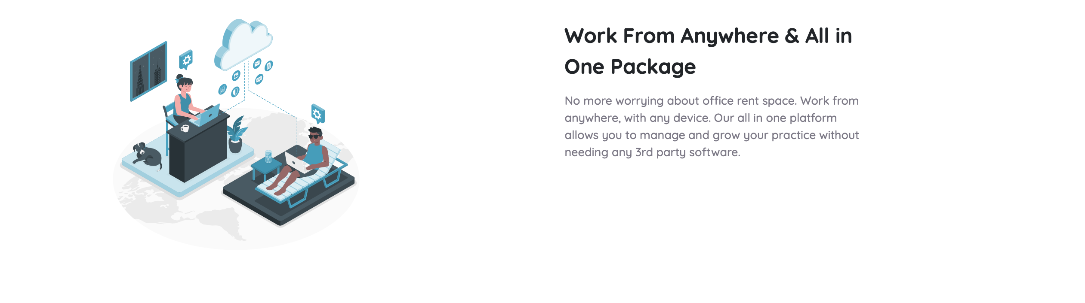
Design
Actual
In Design there are 2 statements but in actual there is only 1 statement.

Slide 11
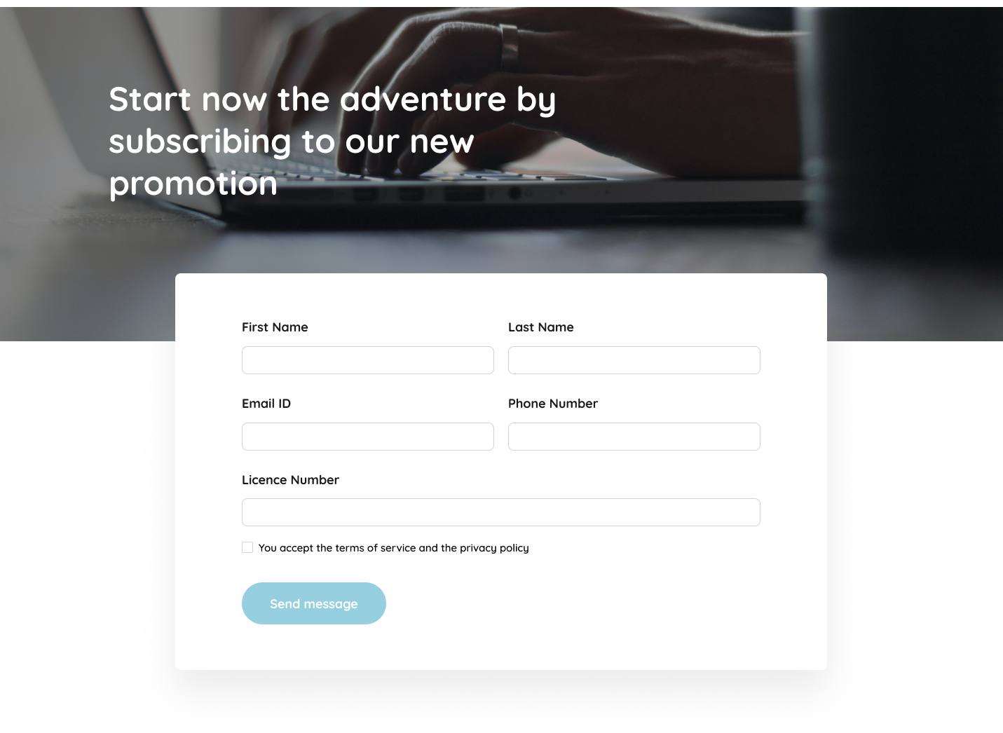
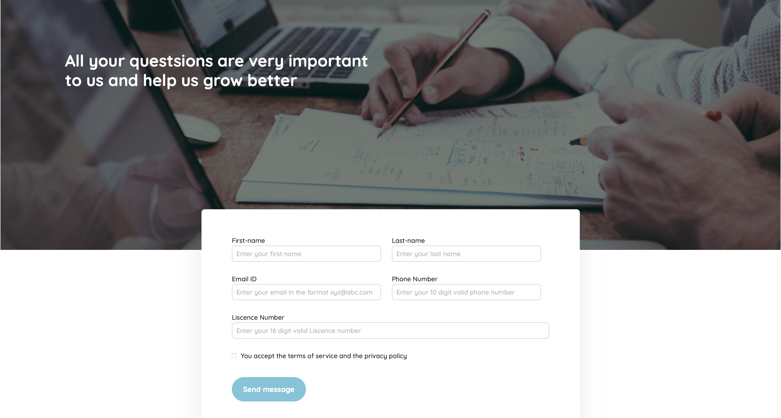
Design
Actual
In Design there is statement that statement is not matching with Actual.

Slide 12
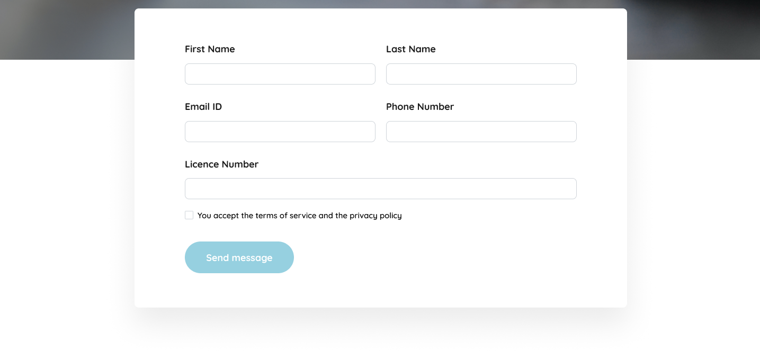
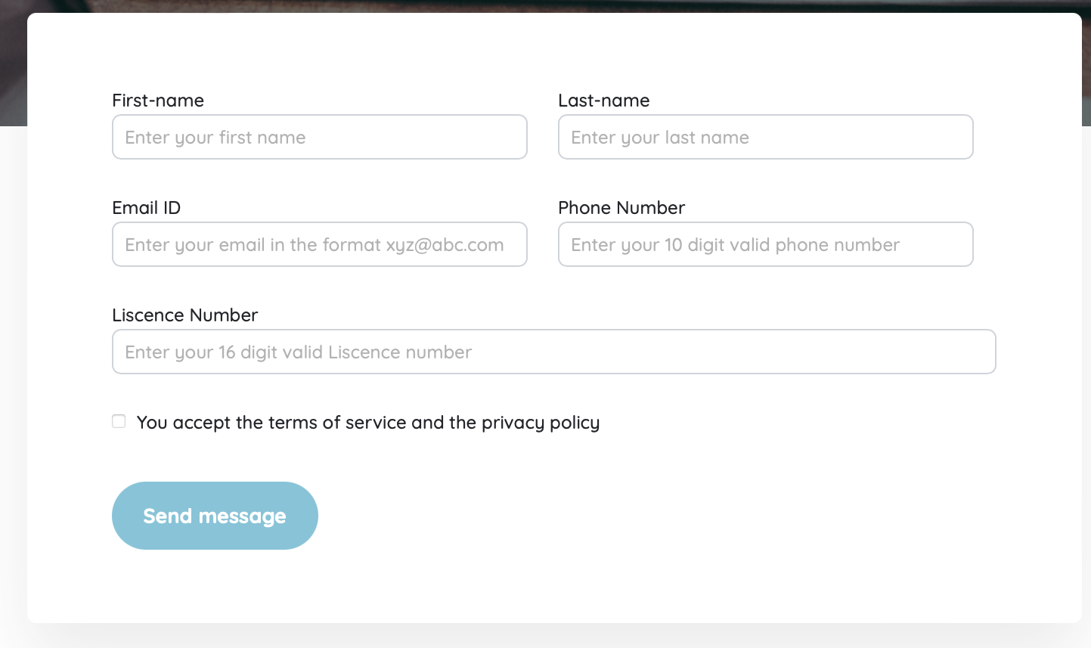
Design
Actual
The First name and Last name are different.

Slide 13
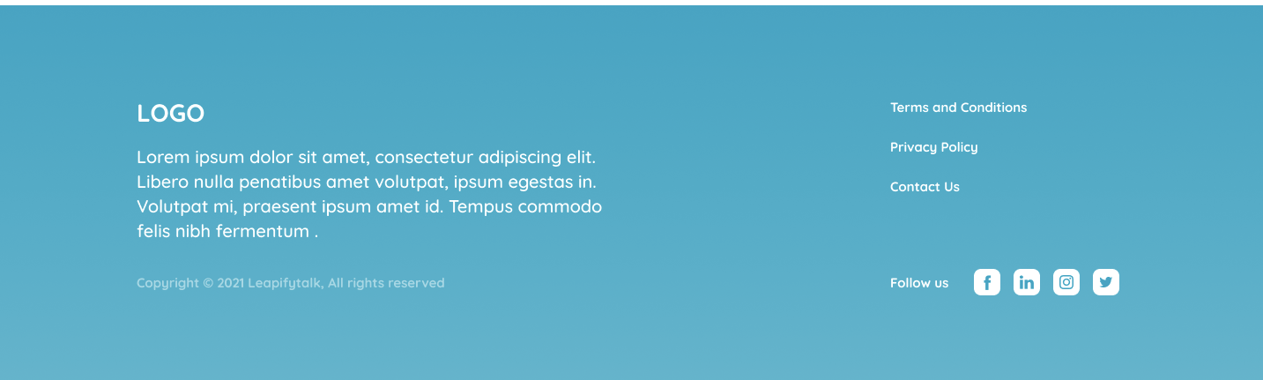
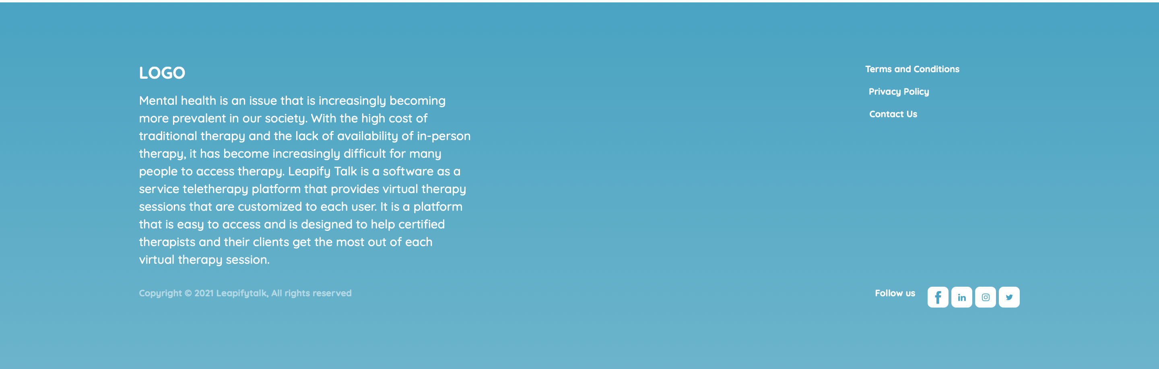
Design
Actual
The Logo below language in Counselor job also different.

Slide 14
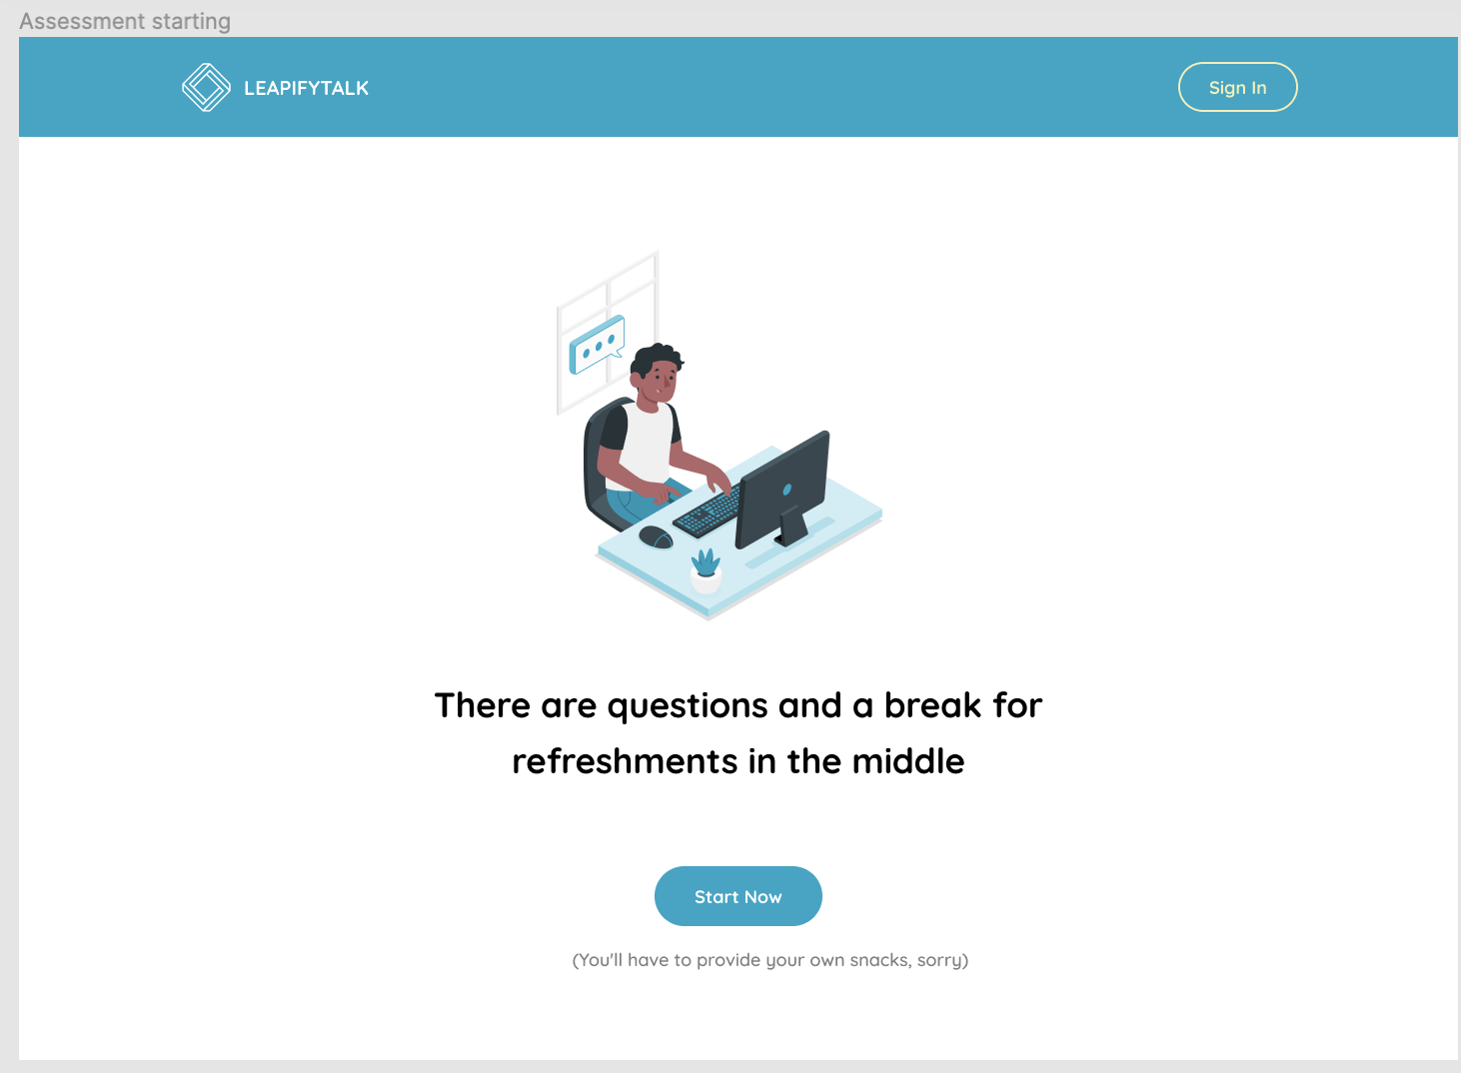
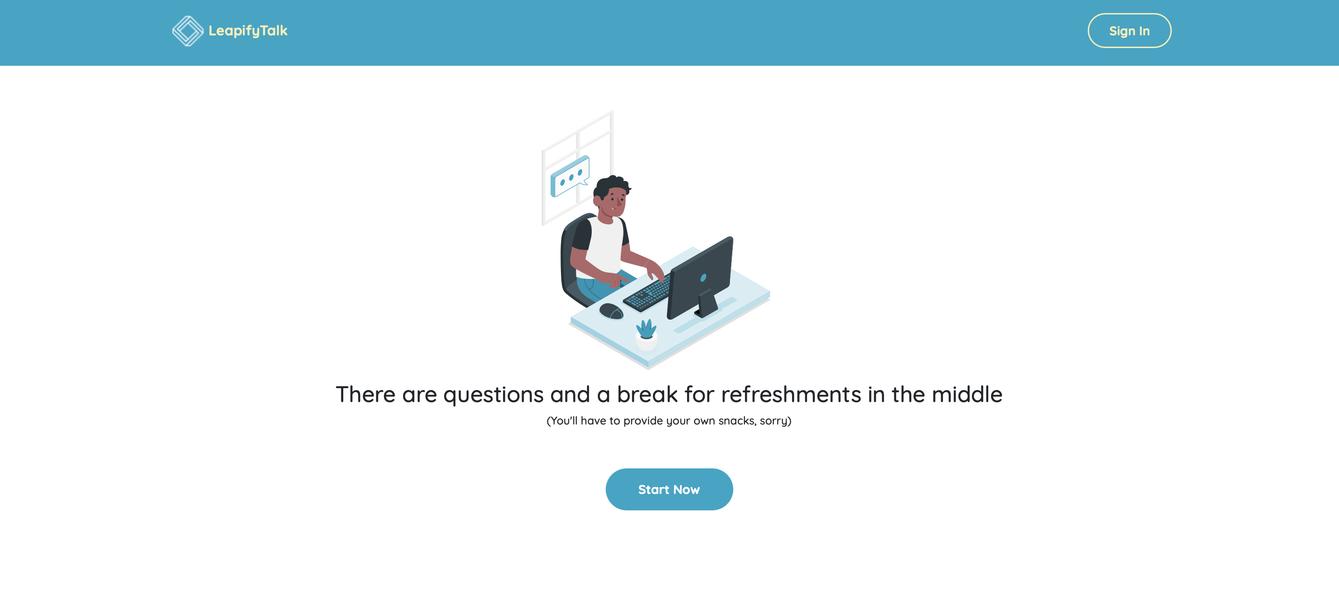
Design
Actual
The application name is in Lowercase letters.

Slide 15
Design
Actual
The statement is above the Start Now.

Slide 16
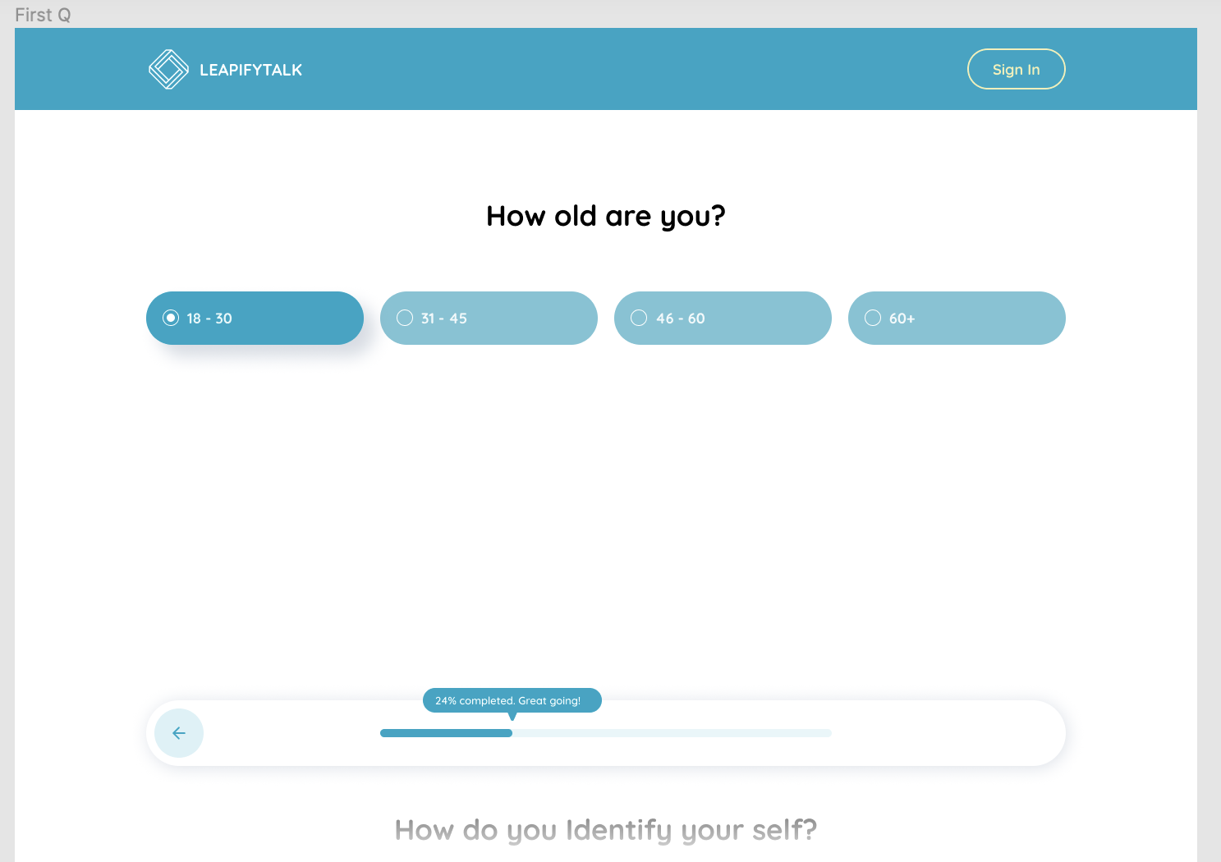
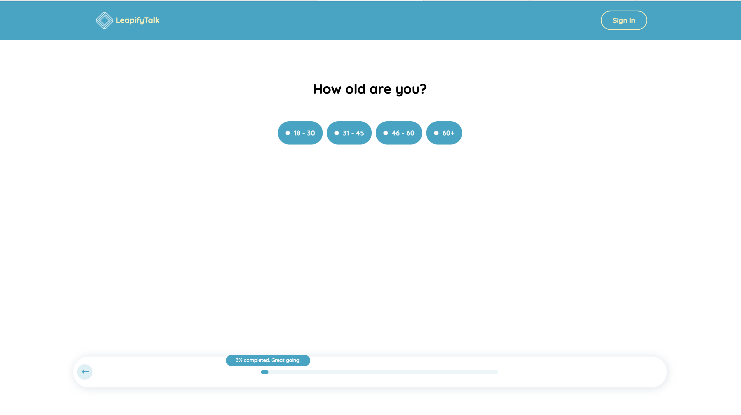
Design
Actual
Age bar size is different and all are highlighting while clicking one option.

Slide 17
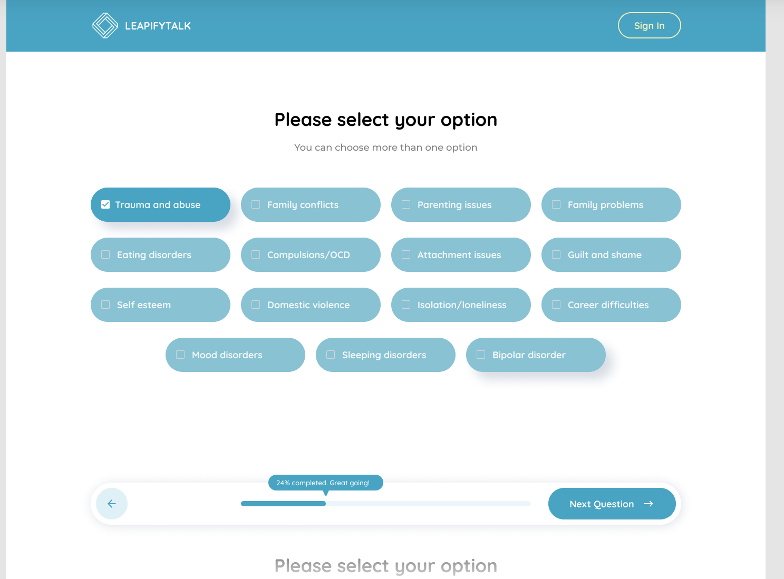
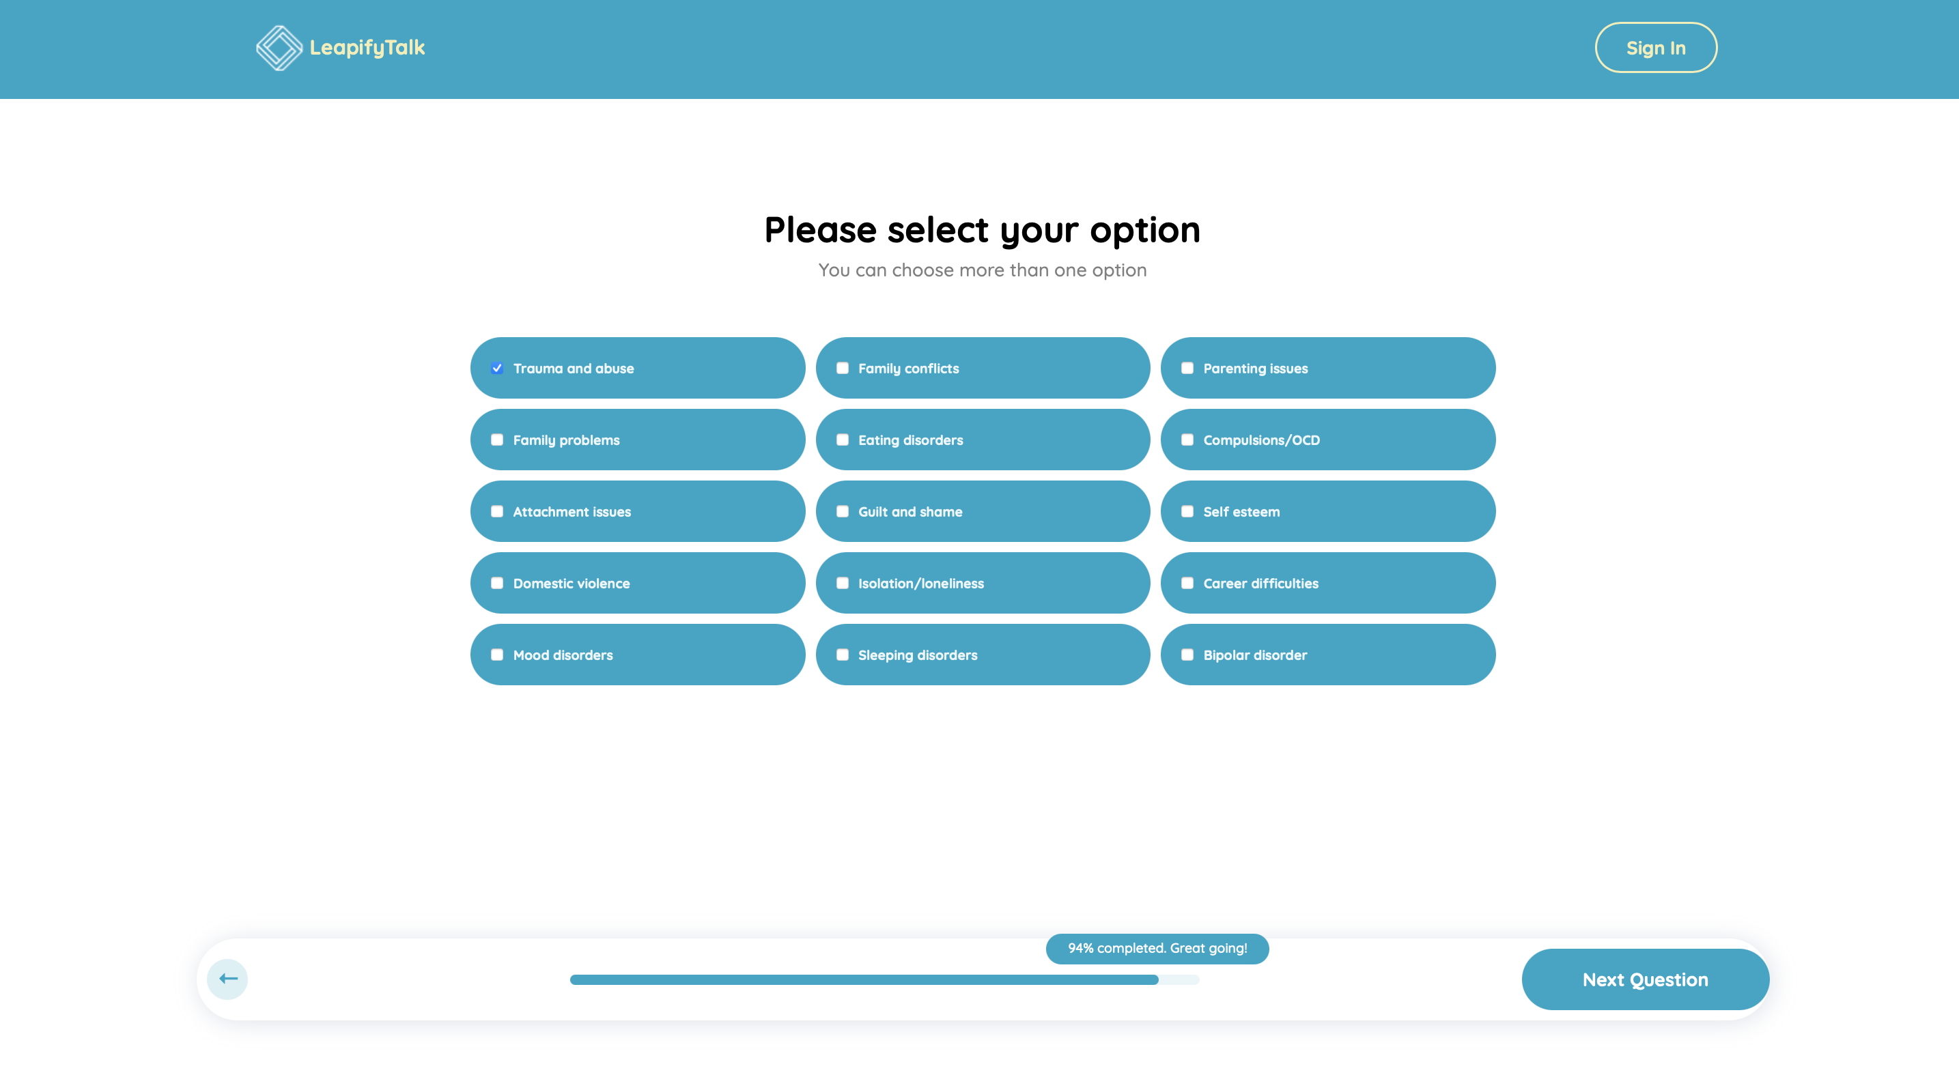
Design
Actual
Percentage is different and all bars are same in colour while clicking also.

Slide 18
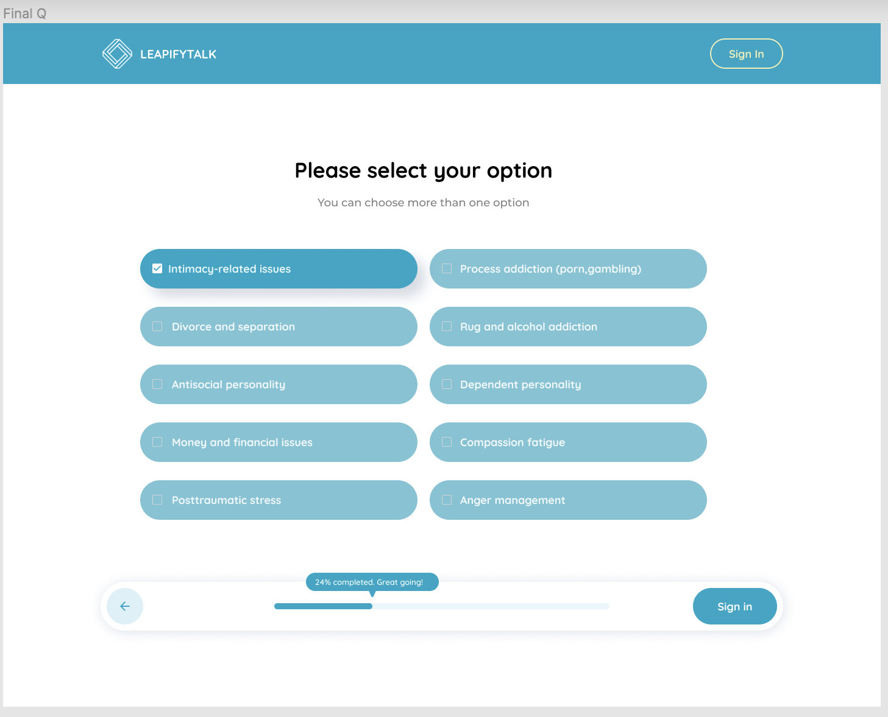
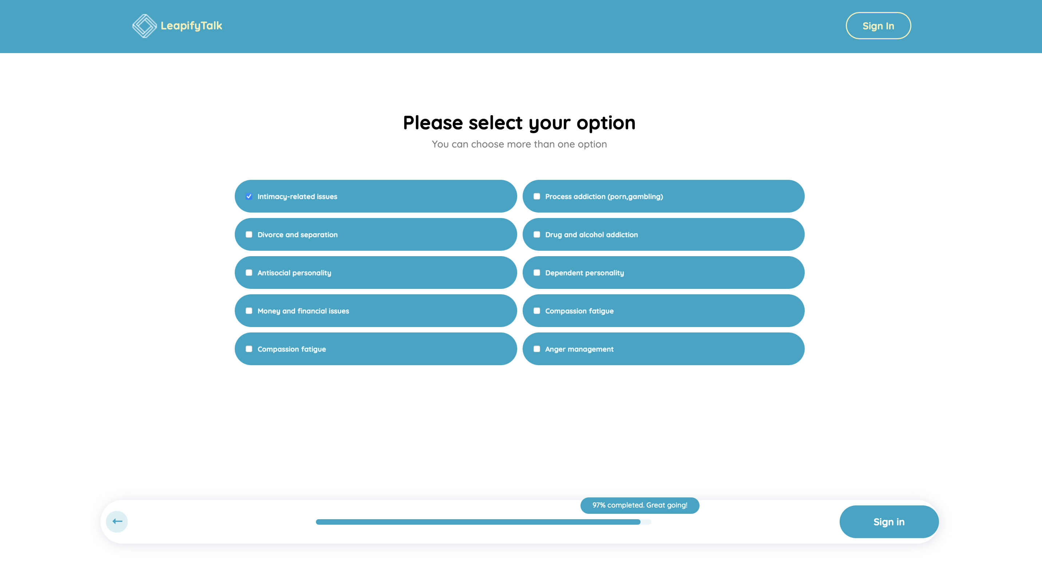
Design
Actual
Percentage is different and all bars are same in colour while clicking also.
Not able signin after answering for all questions.

Slide 19
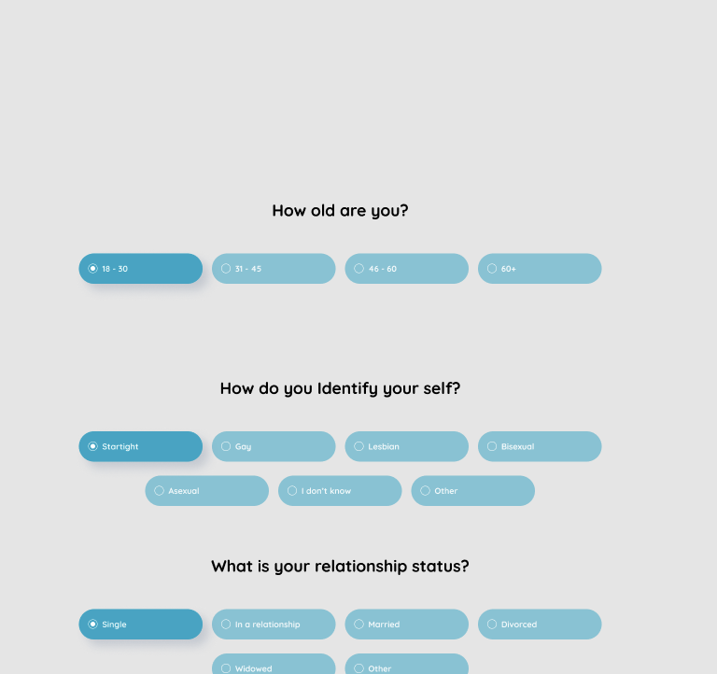
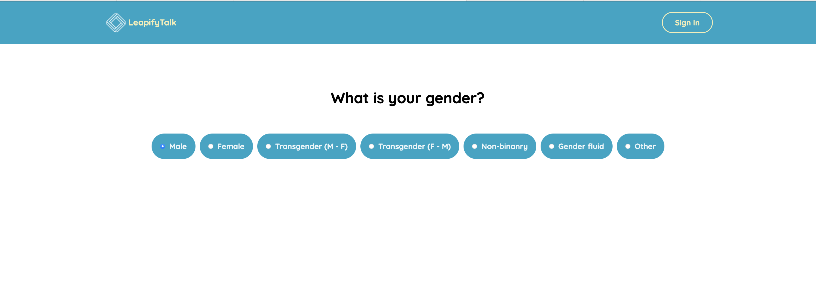
Design
Actual
In design we don’t have gender specification.

Slide 20
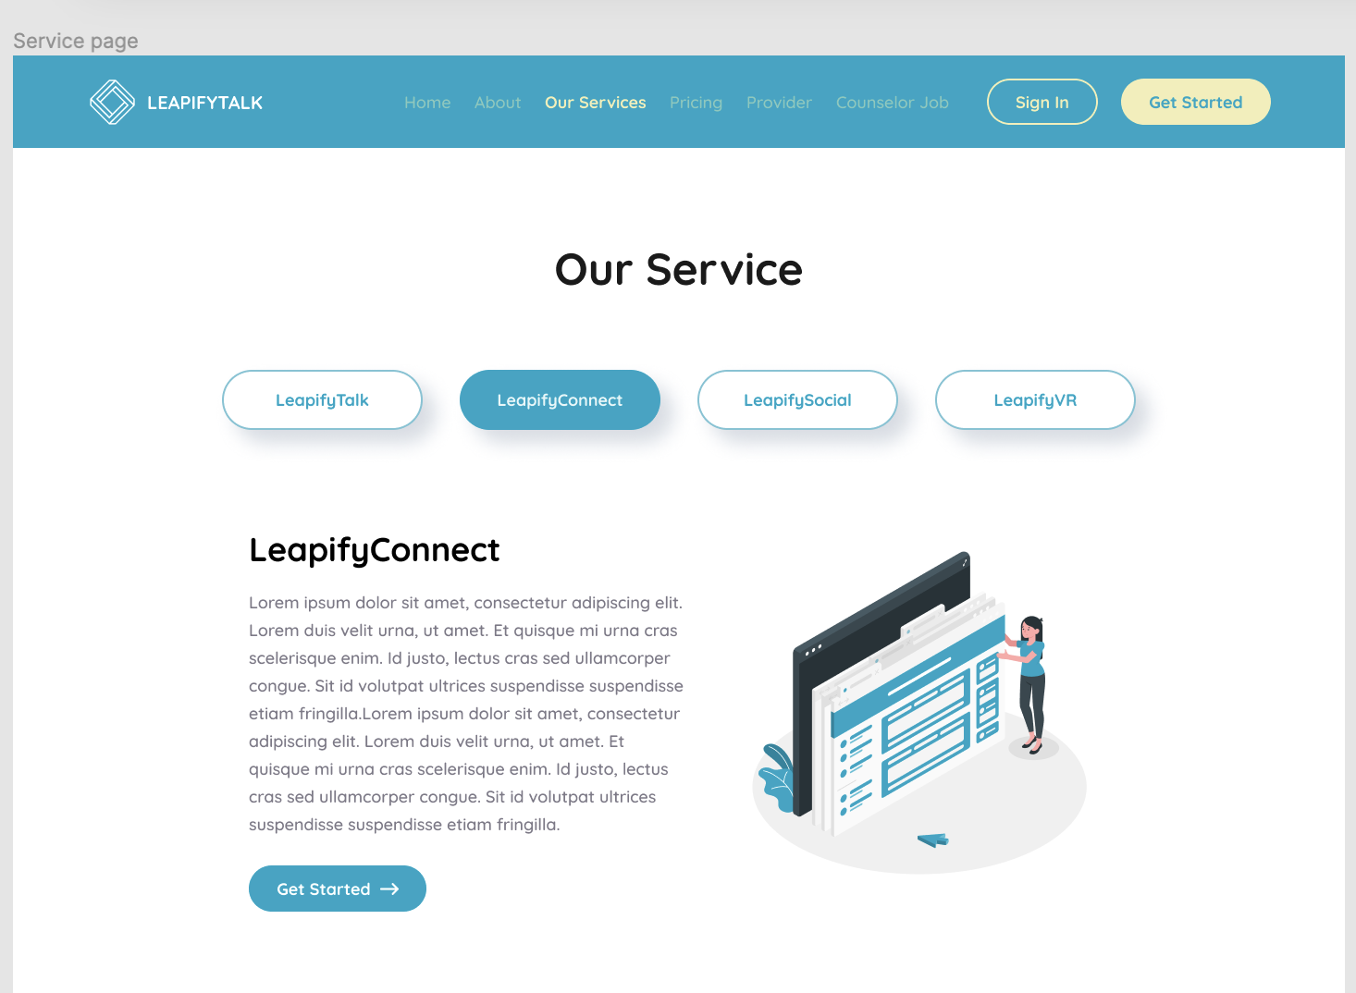
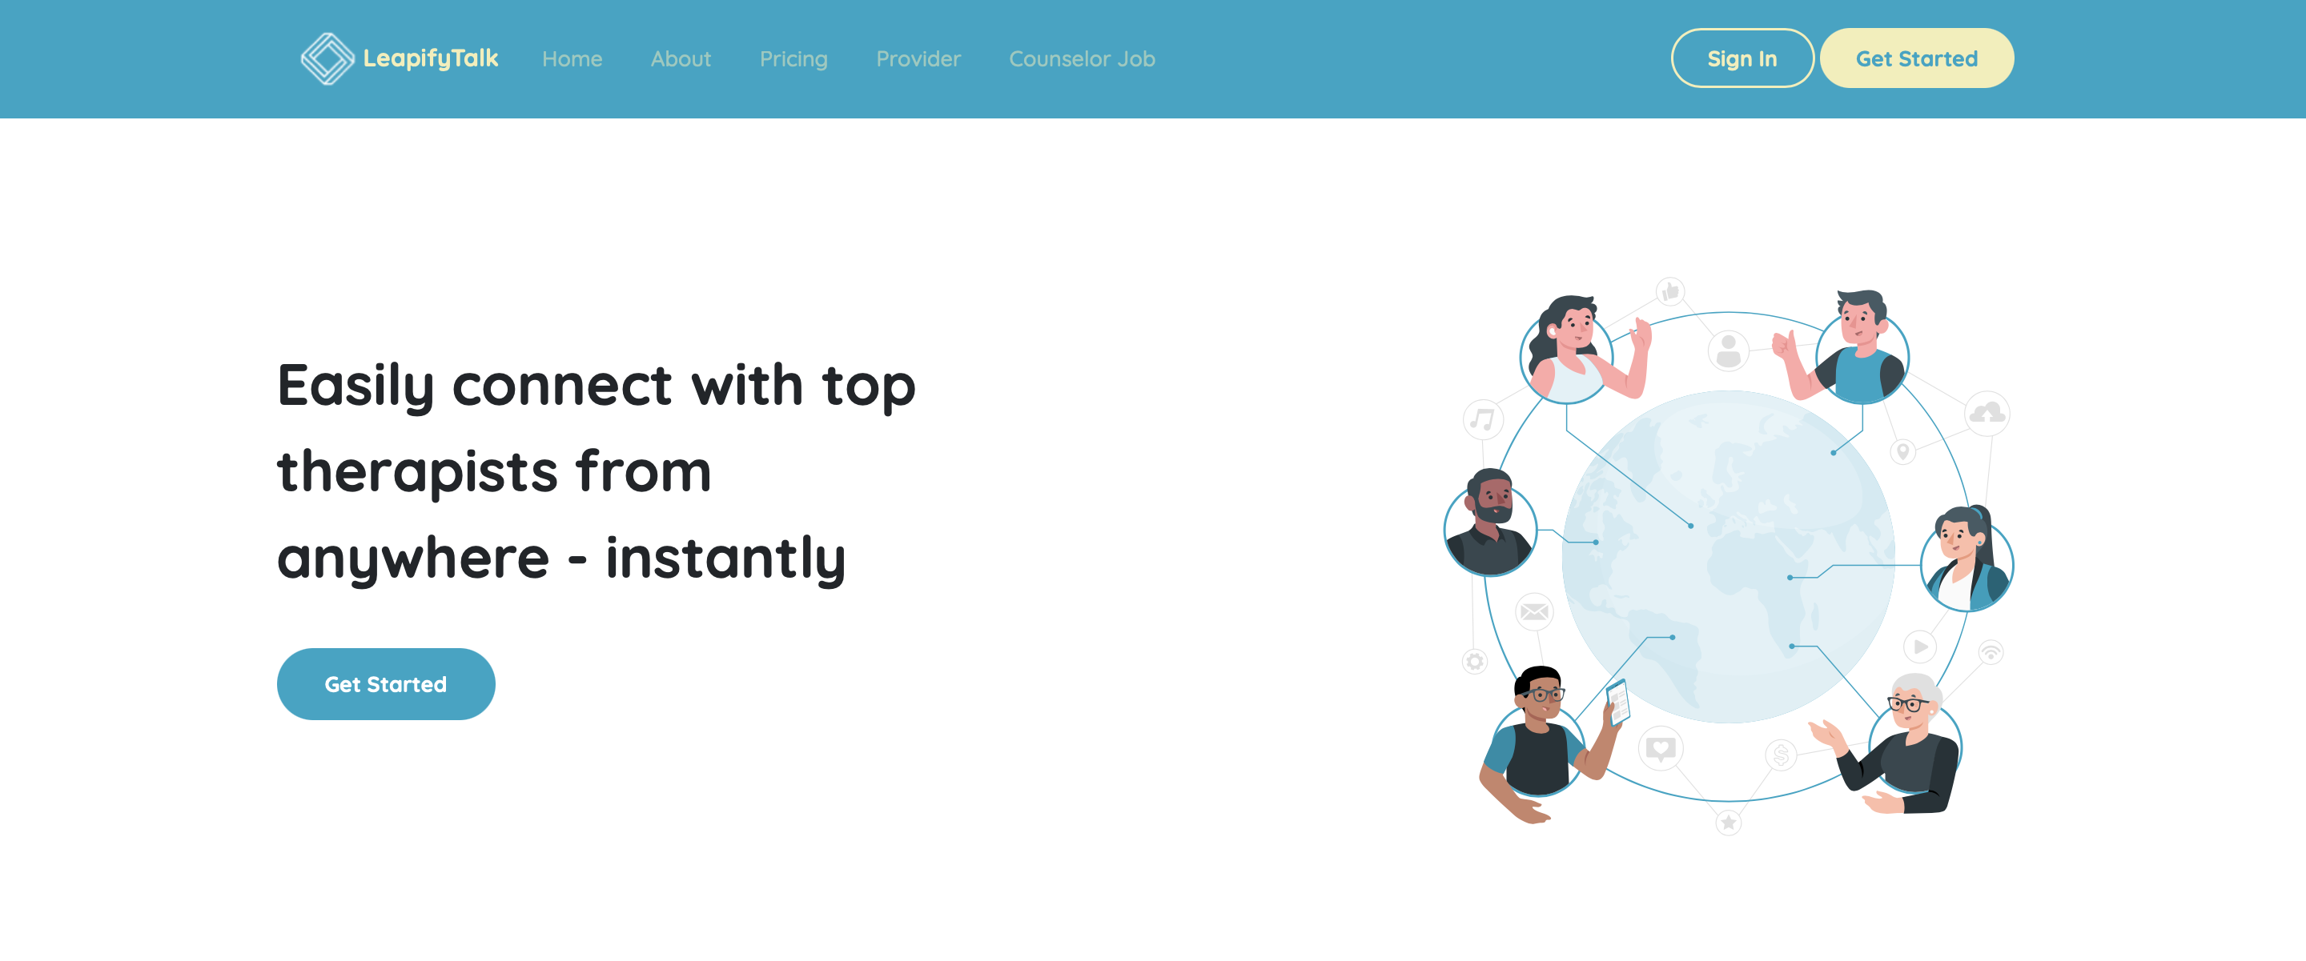
Design
Actual
Our Services bar is missed in Actual.

Slide 21
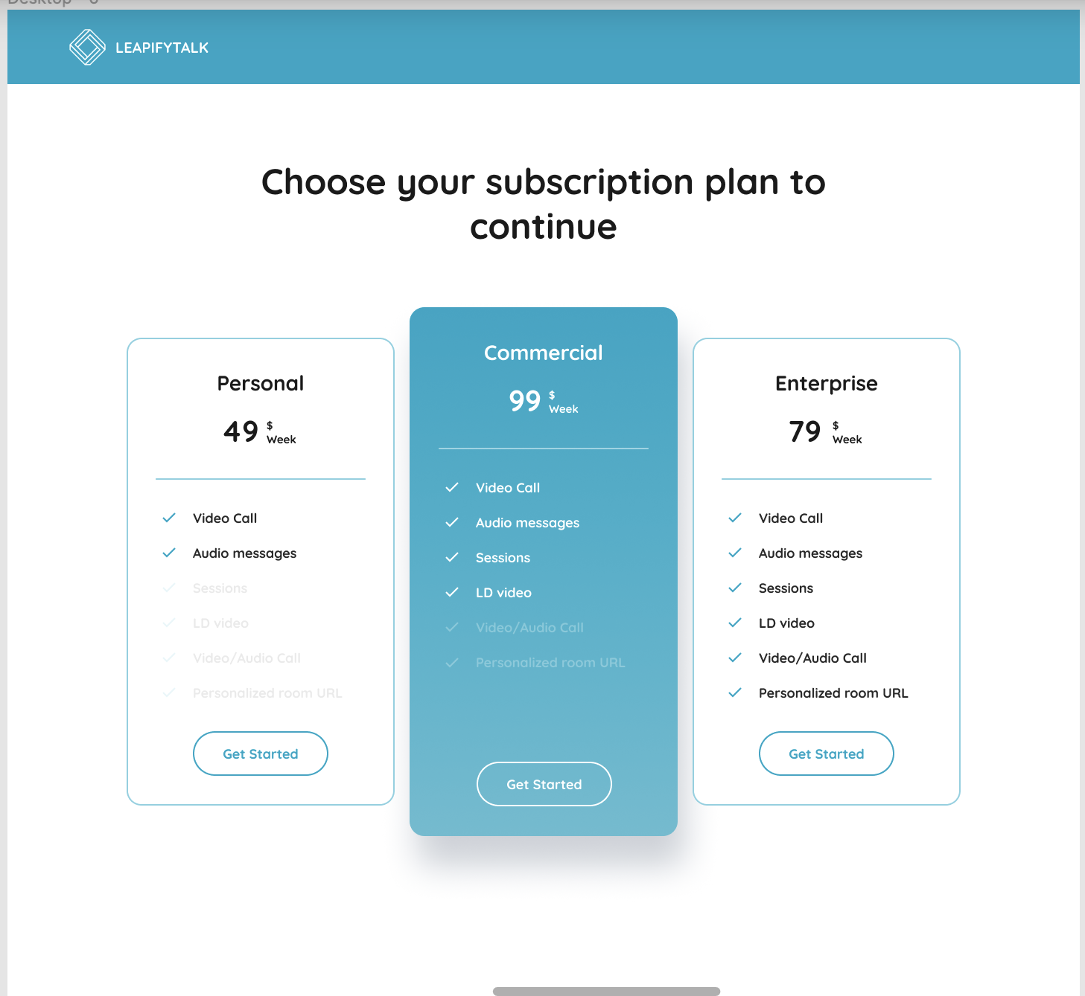
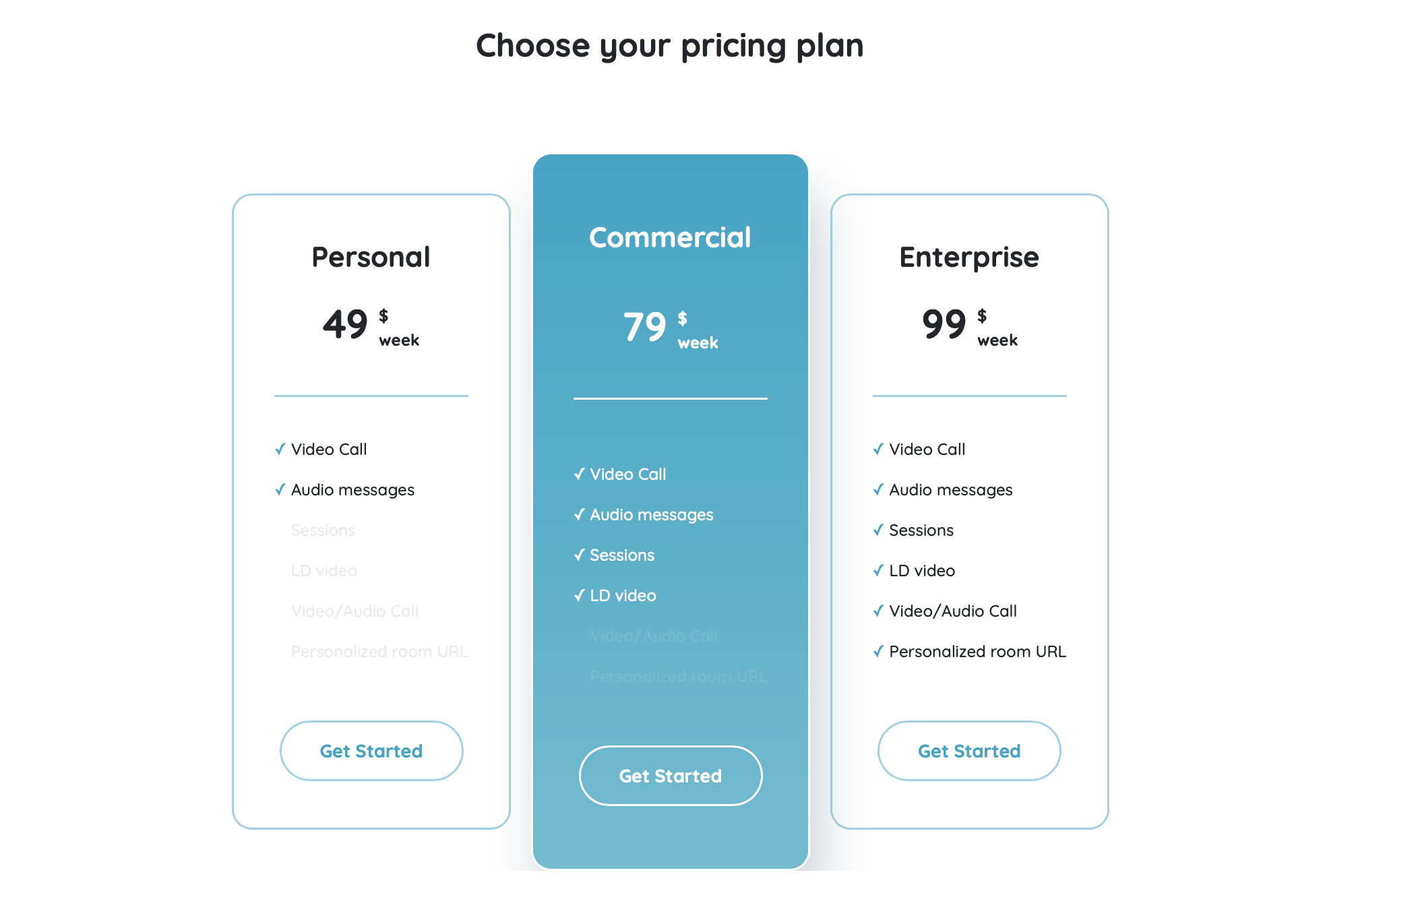
Design
Actual
Commercial and Enterprise cost are different.

Slide 22
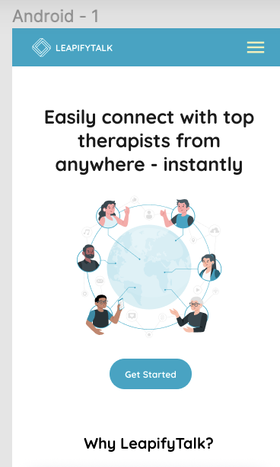
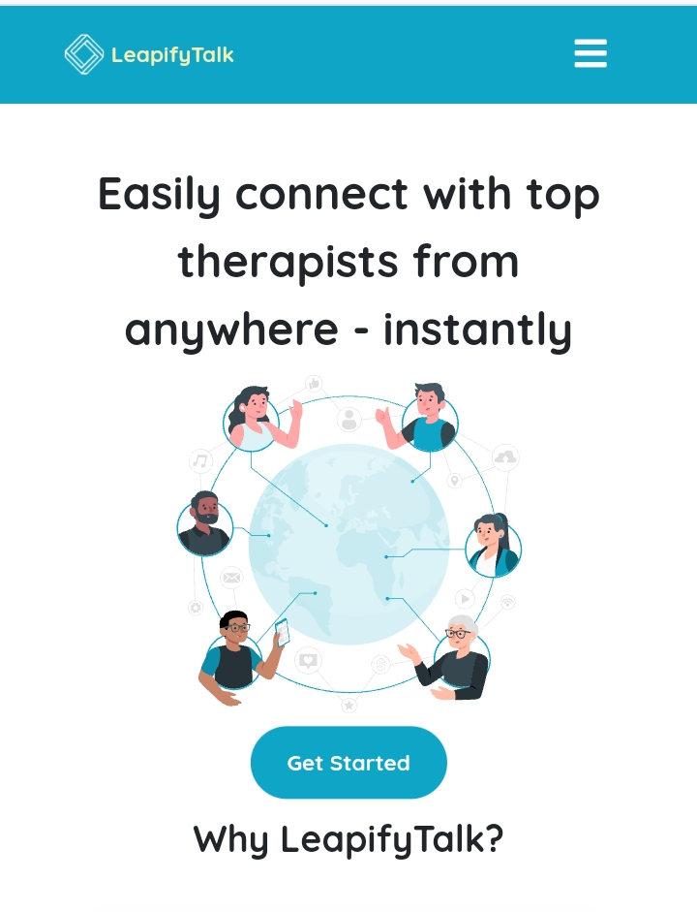
Android Testing
Design
Actual
Get started and Why Leapify Talk there is more gap.

Slide 23
Design
Actual
Application name is in Lowercase Letters.

Slide 24
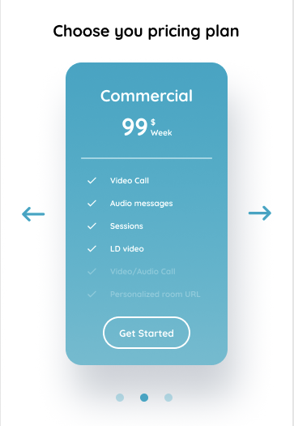
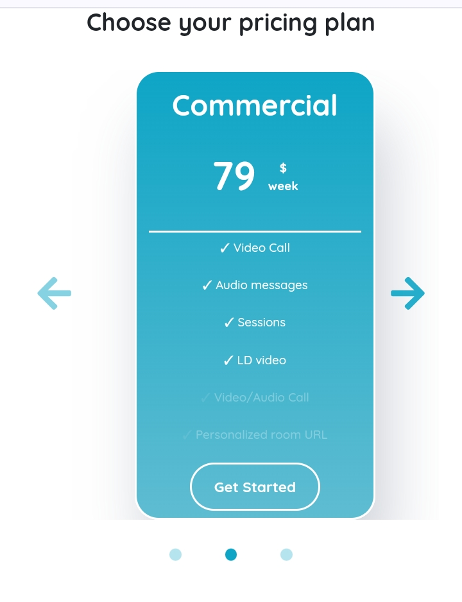
Design
Actual
Commercial cost is different

Slide 25
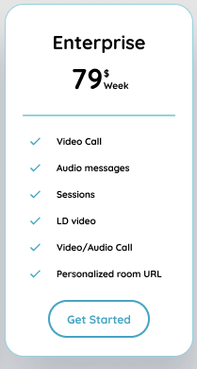
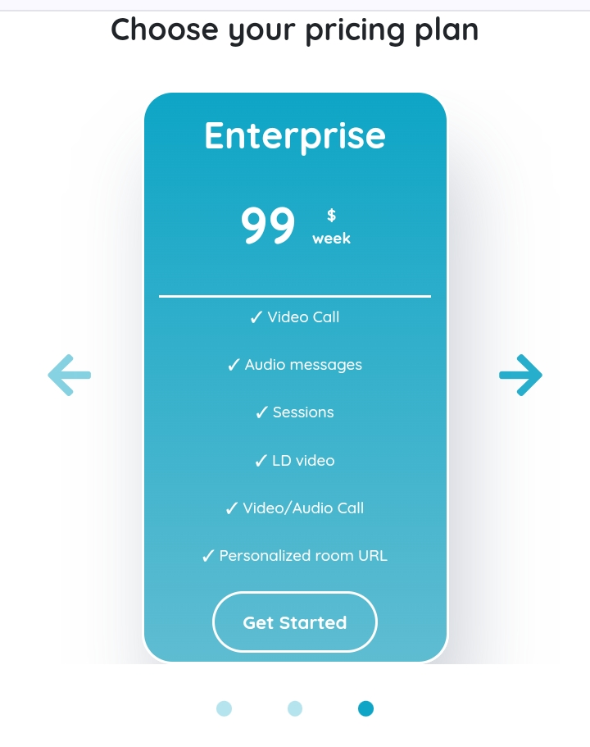
Design
Actual
Enterprise cost is different

Slide 26
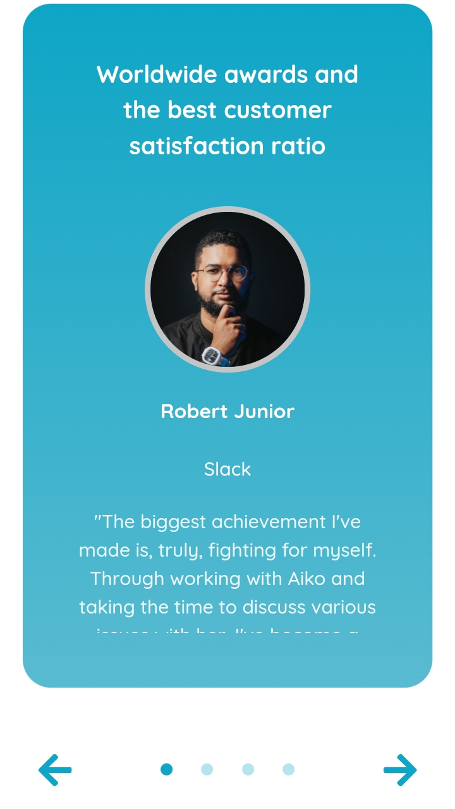
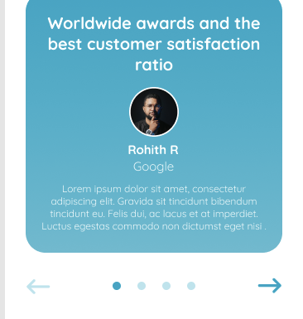
Design
Actual
Frist slide person’s name is different

Slide 27
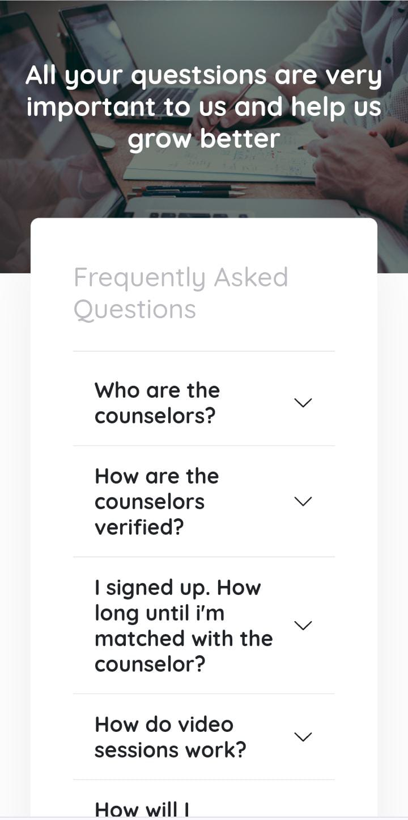
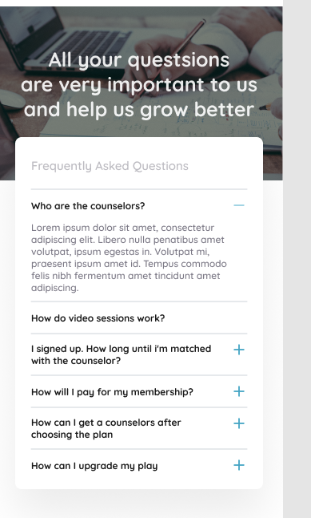
Design
Actual
Scrolling buttons are different

Slide 28
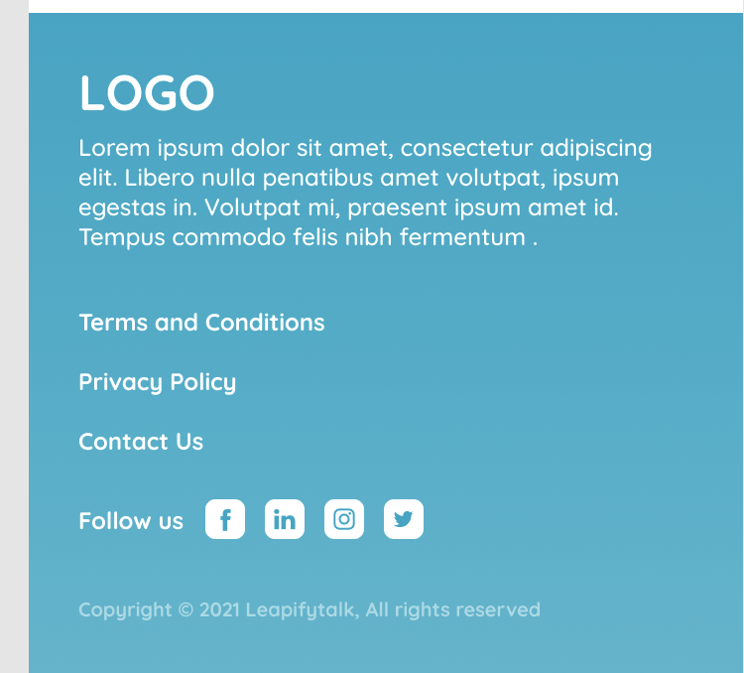
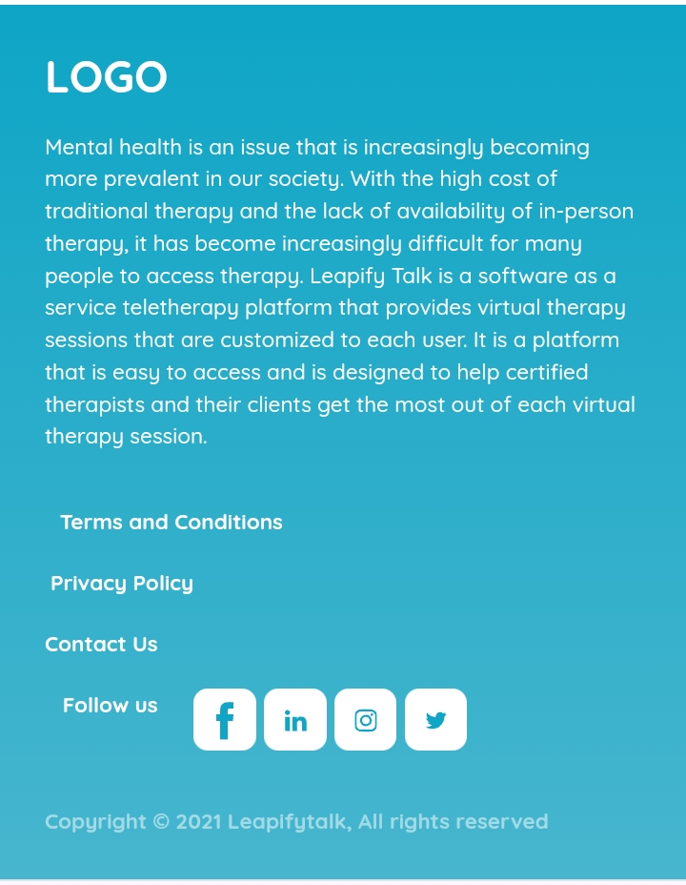
Design
Actual
Language is different

Slide 29
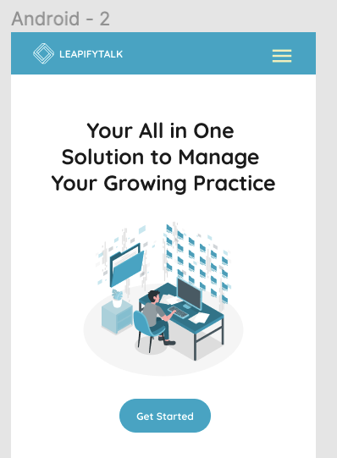
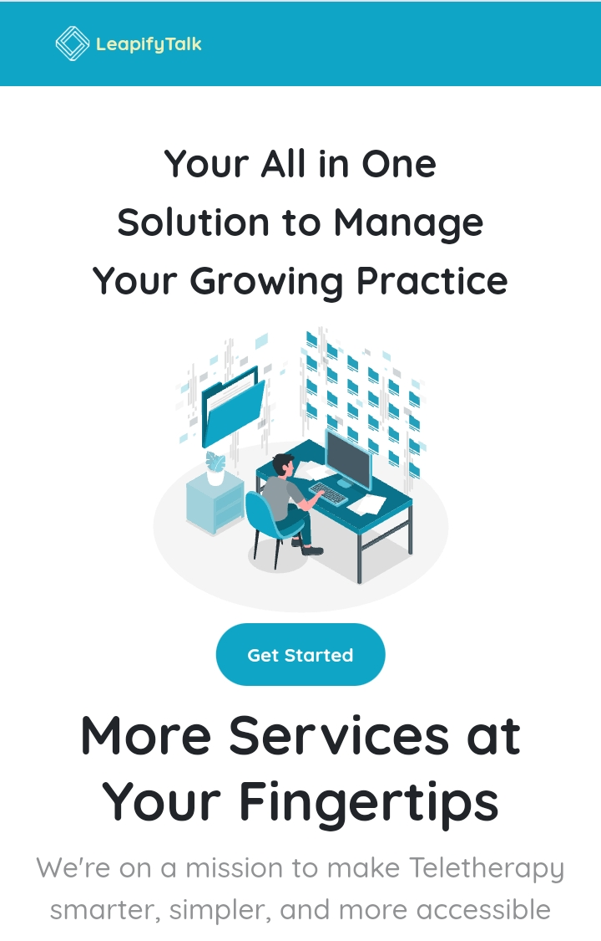
Design
Actual
Menu lines are missed at the right corner of the page.

Slide 30

Design
Actual
The gap is less between Get Stared and more serivces.

Slide 31


Design
Actual
The Frist name and Last name are different.

Slide 32
Design
Actual
The statement is different.

Slide 33


Design
Actual
In Design there is menu bar, In Actual there is sign in button.

Slide 34


Design
Actual
Age bars are different in size and alignment are not correctly assigned.

Slide 35


Design
Actual
Our service bar is missed

Slide 36


Design
Actual
Unable to click the social media links.

Slide 37


